Slide 1

OOSA&D(2017) 07 随遇而安: 适配器模式与外观模式
07 Being Adaptive the Adapter and Facade Patterns

Slide 2
Glossary
pattern ['pæt(ə)n] a model considered worthy of imitation
Client (客户)
Adapter (适配器)
Adaptee (被适配者)
Interface (接口)
Vendor Class（厂商类）
Incompatible interfaces (不相容的接口)
Dalian Neusoft University of Information © Copyright

Slide 3
Agenda
A Case Analysis
Design Pattern: the Adapter Pattern
An Application for example
An experiment in class
Practices of design pattern as homework
Dalian Neusoft University of Information © Copyright

Slide 4
Agenda
A Case Analysis
Design Pattern: the Adapter Pattern
An Application for example
An experiment in class
Practices of design pattern as homework
Dalian Neusoft University of Information © Copyright

Slide 5
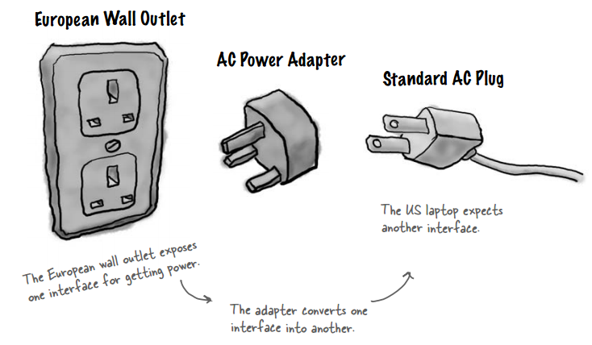
1. A Case Analysis
Adapters all around us
Dalian Neusoft University of Information © Copyright

Slide 6
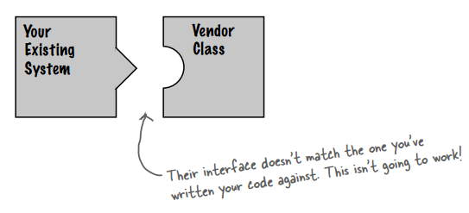
1. A Case Analysis
Object oriented adapters
Dalian Neusoft University of Information © Copyright

Slide 7
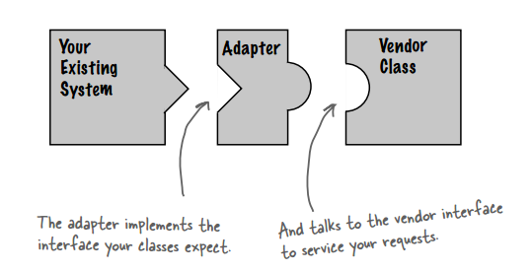
1. A Case Analysis
Object oriented adapters
Dalian Neusoft University of Information © Copyright

Slide 8
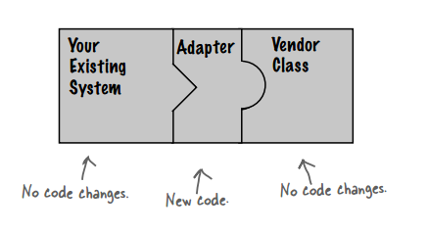
1. A Case Analysis
Object oriented adapters
Dalian Neusoft University of Information © Copyright

Slide 9

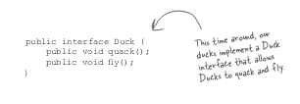
1. A Case Analysis
If it walks like a duck and quacks like a duck,
then it must might be a duck turkey wrapped
with a duck adapter...

Slide 10
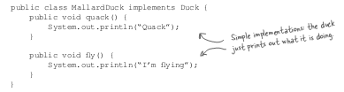
1. A Case Analysis

Slide 11

1. A Case Analysis

Slide 12
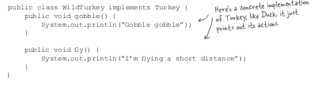
1. A Case Analysis

Slide 13
1. A Case Analysis
public class TurkeyAdapter implements Duck {
Turkey turkey;
public TurkeyAdapter(Turkey turkey) {
this.turkey = turkey;
}
public void quack() {
turkey.gobble();
}
public void fly() {
for(int i=0; i < 5; i++) {
turkey.fly();
}
}
}

Slide 14
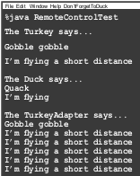
1. A Case Analysis
public class DuckTestDrive {
public static void main(String[] args) {
MallardDuck duck = new MallardDuck();
WildTurkey turkey = new WildTurkey();
Duck turkeyAdapter = new TurkeyAdapter(turkey);
System.out.println(“The Turkey says...”);
turkey.gobble();
turkey.fly();
System.out.println(“\nThe Duck says...”);
testDuck(duck);
System.out.println(“\nThe TurkeyAdapter says...”);
testDuck(turkeyAdapter);
}
static void testDuck(Duck duck) {
duck.quack();
duck.fly();
}
}

Slide 15
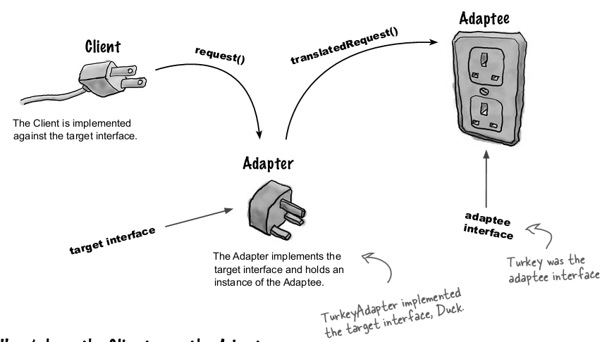
1. A Case Analysis
The Adapter Pattern explained
Dalian Neusoft University of Information © Copyright

Slide 16
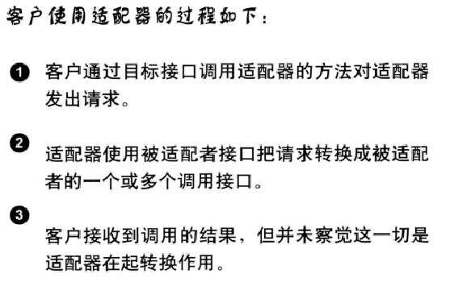

1. A Case Analysis
The Adapter Pattern explained
Dalian Neusoft University of Information © Copyright

Slide 17
Agenda
A Case Analysis
Design Pattern: the Adapter Pattern
An Application for example
An experiment in class
Practices of design pattern as homework
Dalian Neusoft University of Information © Copyright

Slide 18
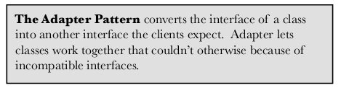

2. Design Pattern
Dalian Neusoft University of Information © Copyright

Slide 19
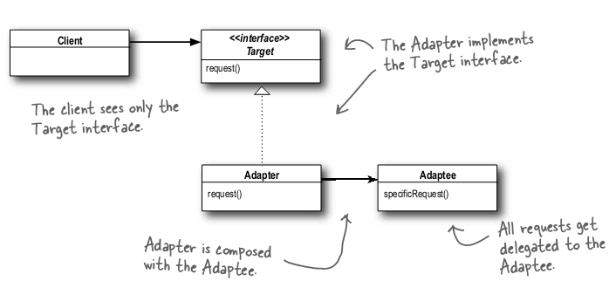

2. Design Pattern
Adapter Pattern Class Diagram
Dalian Neusoft University of Information © Copyright

Slide 20
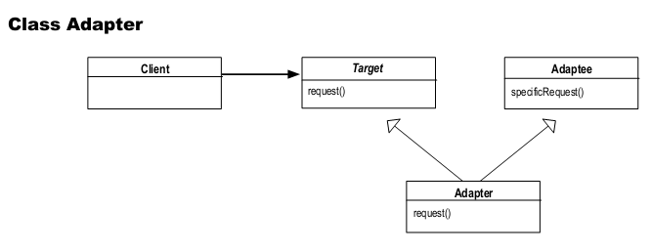
2. Design Pattern
Object and Class adapters
Note: the class adapter uses multiple inheritance, so you can’t do it in Java...
Dalian Neusoft University of Information © Copyright

Slide 21
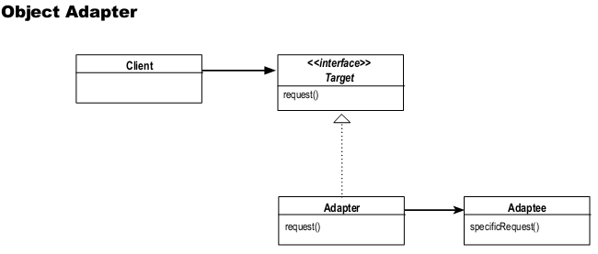
2. Design Pattern
Object and Class adapters
Dalian Neusoft University of Information © Copyright

Slide 22


2. Design Pattern
Object and Class adapters
Note: the class adapter uses multiple inheritance, so you can’t do it in Java...
Dalian Neusoft University of Information © Copyright

Slide 23
2. Design Pattern
Object and Class adapters
Dalian Neusoft University of Information © Copyright

Slide 24
Agenda
A Case Analysis
Design Pattern: the Adapter Pattern
An Application for example
An experiment in class
Practices of design pattern as homework
Dalian Neusoft University of Information © Copyright

Slide 25

3. An Application for example
Adapting an Enumeration to an Iterator
Old world Enumerators
Dalian Neusoft University of Information © Copyright

Slide 26
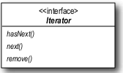
3. An Application for example
Adapting an Enumeration to an Iterator
New world Iterators
Dalian Neusoft University of Information © Copyright

Slide 27
3. An Application for example
Adapting an Enumeration to an Iterator
We are often faced with legacy code that exposes the Enumerator interface, yet we’d like for our new code to use only Iterators. It looks like we need to build an adapter
Dalian Neusoft University of Information © Copyright

Slide 28
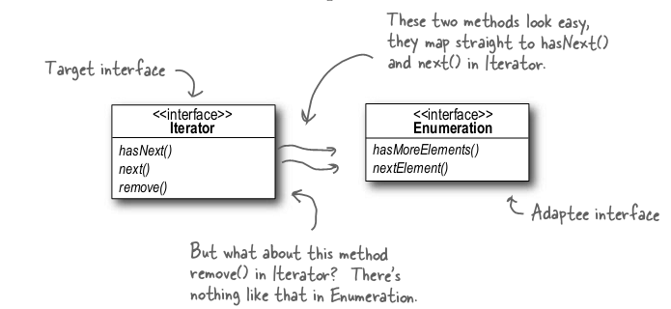
3. An Application for example
Adapting an Enumeration to an Iterator
Dalian Neusoft University of Information © Copyright

Slide 29
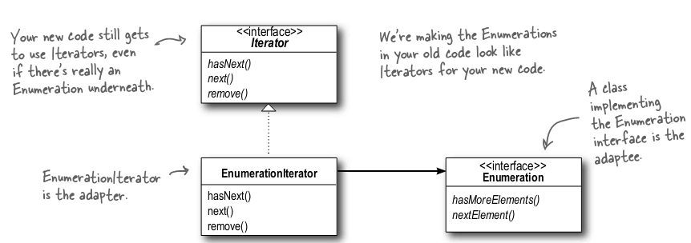
3. An Application for example
Adapting an Enumeration to an Iterator Class Diagram

Slide 30
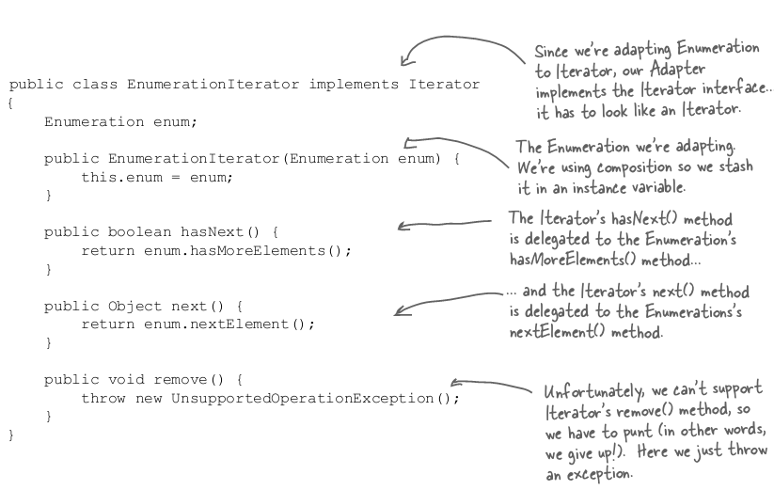
3. An Application for example

Slide 31
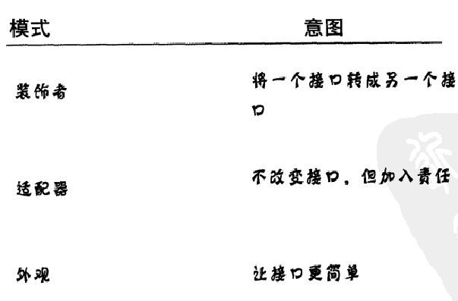
And now for something different…

Slide 32
Agenda
A Case Analysis
Design Pattern: the Facade Pattern
An Application for example
An experiment in class
Practices of design pattern as homework
Dalian Neusoft University of Information © Copyright

Slide 33
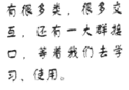

1. A Case Analysis
Home Sweet Home Theater
Dalian Neusoft University of Information © Copyright

Slide 34
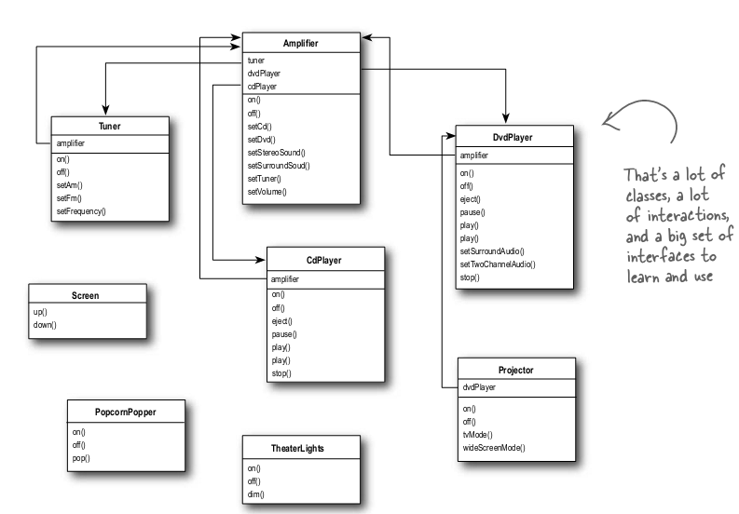
1. A Case Analysis
Dalian Neusoft University of Information © Copyright

Slide 35
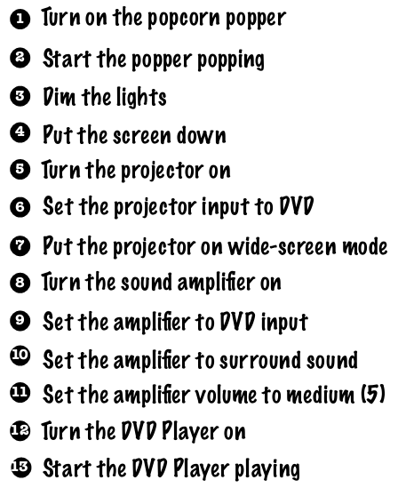
1. A Case Analysis
Watching a movie (the hard way)
Dalian Neusoft University of Information © Copyright

Slide 36
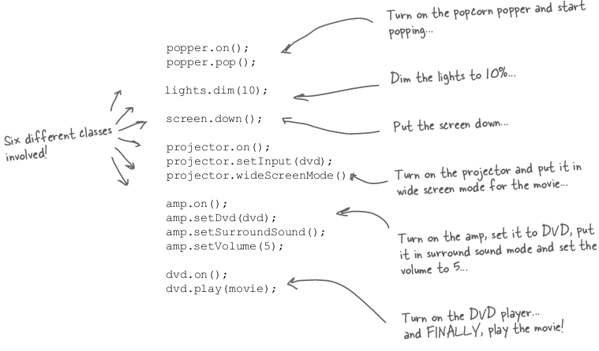
1. A Case Analysis
Dalian Neusoft University of Information © Copyright

Slide 37

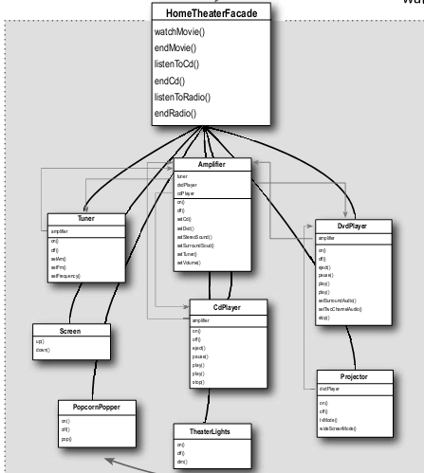
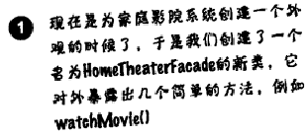
1. A Case Analysis
how the Facade operates:
Dalian Neusoft University of Information © Copyright

Slide 38
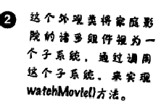
1. A Case Analysis
Dalian Neusoft University of Information © Copyright

Slide 39
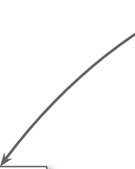

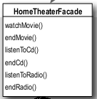
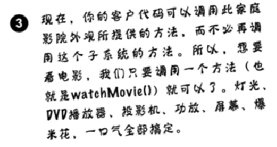
1. A Case Analysis
Dalian Neusoft University of Information © Copyright

Slide 40
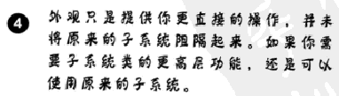
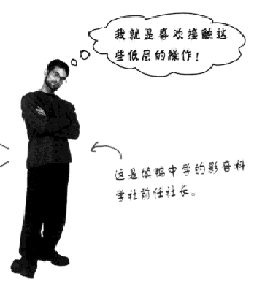
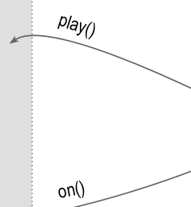
1. A Case Analysis
Dalian Neusoft University of Information © Copyright

Slide 41
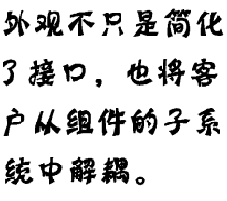
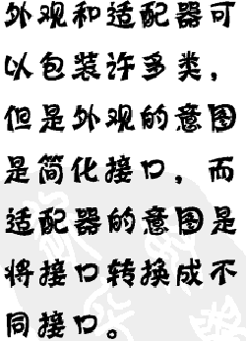
1. A Case Analysis
Dalian Neusoft University of Information © Copyright

Slide 42
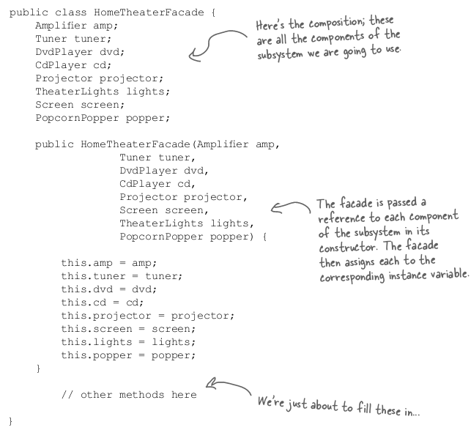
1. A Case Analysis
Constructing
your home
theater facade
Dalian Neusoft University of Information © Copyright

Slide 43
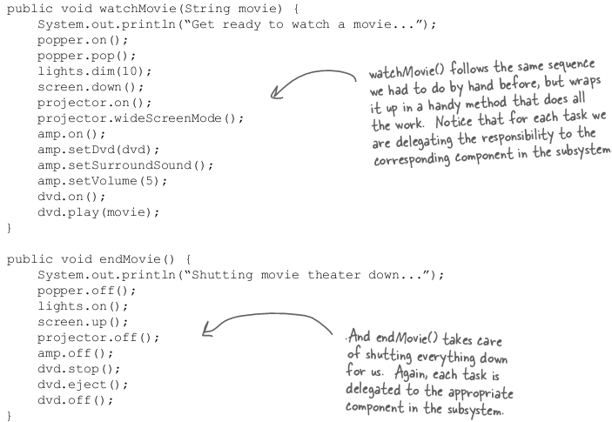
1. A Case Analysis
Implementing the simplified interface
Dalian Neusoft University of Information © Copyright

Slide 44

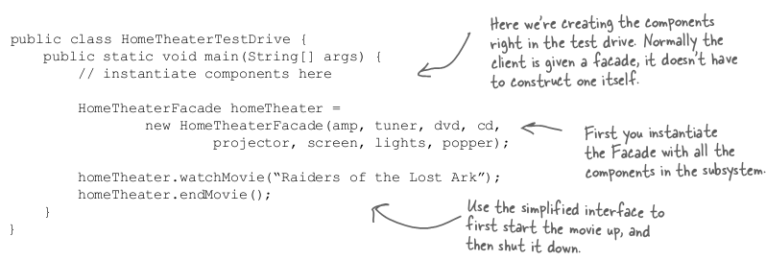
1. A Case Analysis
Time to watch a movie (the easy way)
Dalian Neusoft University of Information © Copyright

Slide 45
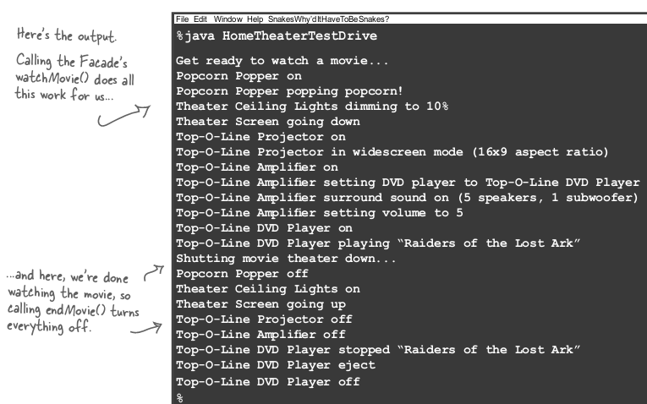
1. A Case Analysis
Time to watch a movie (the easy way)
Dalian Neusoft University of Information © Copyright

Slide 46
Agenda
A Case Analysis
Design Pattern: the Facade Pattern
An Application for example
An experiment in class
Practices of design pattern as homework
Dalian Neusoft University of Information © Copyright

Slide 47
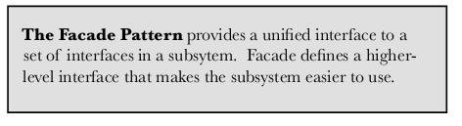
2. Design Pattern
Dalian Neusoft University of Information © Copyright

Slide 48
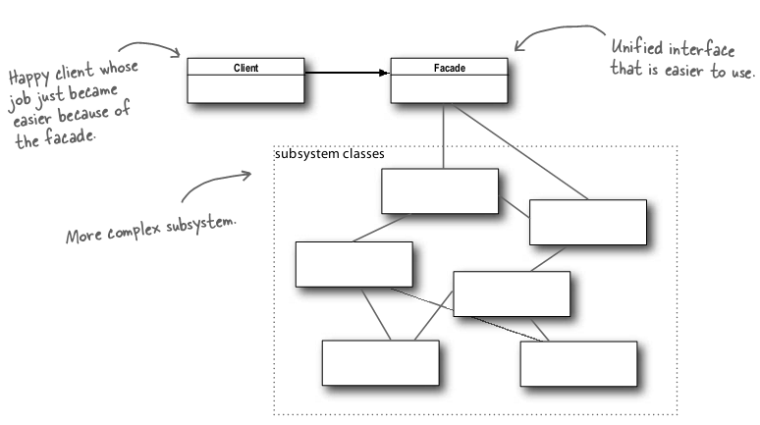
2. Design Pattern
The Facade Pattern Class Diagram
Dalian Neusoft University of Information © Copyright

Slide 49
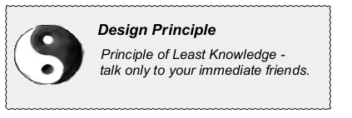
2. Design Pattern
The Principle of Least Knowledge
Dalian Neusoft University of Information © Copyright

Slide 50

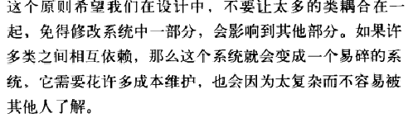
2. Design Pattern
The Principle of Least Knowledge
Dalian Neusoft University of Information © Copyright

Slide 51


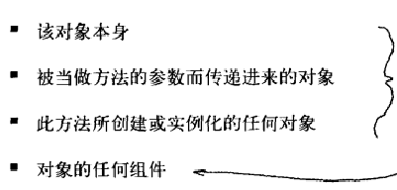


2. Design Pattern
How NOT to Win Friends and Influence Objects
Dalian Neusoft University of Information © Copyright

Slide 52
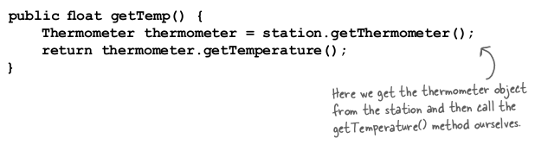

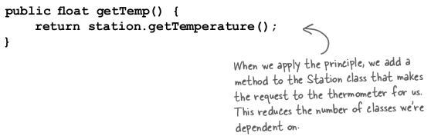

2. Design Pattern
How NOT to Win Friends and Influence Objects
Dalian Neusoft University of Information © Copyright

Slide 53

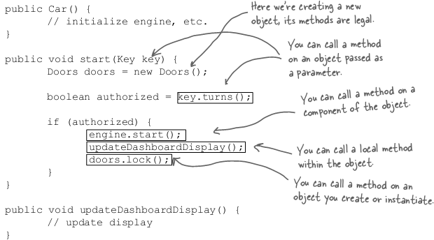
2. Design Pattern
Keeping your method calls in bounds...
Dalian Neusoft University of Information © Copyright

Slide 54
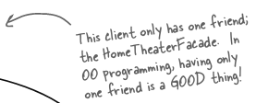


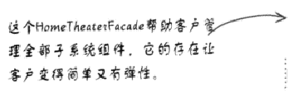
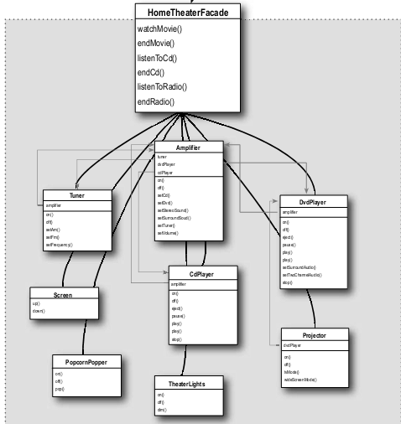
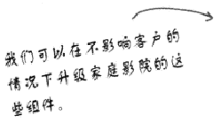

2. Design Pattern
The Facade and the Principle of Least Knowledge
Dalian Neusoft University of Information © Copyright

Slide 55
Agenda
A Case Analysis
Design Pattern: the Adapter Pattern
An Application for example
An experiment in class
Practices of design pattern as homework
Dalian Neusoft University of Information © Copyright

Slide 56
3. An Application for example
Adapting an Enumeration to an Iterator
目前有一个运行良好的系统，该系统有一个类：BookNameList。 BookNameList用Vector存放图书名称，但用户提供的是Vector的枚举器。目前开发组正在设计一个新系统，该系统使用一个NewBookNameList类，在NewBookNameList中的LinkedList存放图书名称，但为了缩短开发周期，决定NewBookNameList中使用已有系统中，请使用适配器模式实现。
Your job is to…
Design the class diagram
program according to your class diagram
Test your design

Slide 57

3. An Application for example

Slide 58


3. An Application for example

Slide 59


3. An Application for example

Slide 60

3. An Application for example

Slide 61


3. An Application for example

Slide 62
Agenda
A Case Analysis
Design Pattern: the Adapter Pattern
An Application for example
An experiment in class
Practices of design pattern as homework
Dalian Neusoft University of Information © Copyright

Slide 63
4. An experiment in class
An Electric Outlet system
用户已经有一个两相插座（ TwoElectricOutlet ），新买一个三相插座（ ThreeElectricOutlet ），洗衣机（WashingMachine）使用三相插座，电视机（TV）用两相插座。
现在用户想用新买的三相插座来使用电视机和洗衣机 。
Your job is to…
Design the class diagram
program according to your class diagram
Test your design
Dalian Neusoft University of Information © Copyright

Slide 64
5. Homework
Finish the homework, which includes 3 tasks.
Dalian Neusoft University of Information © Copyright

